Slide 1
Campus placement prediction
Technology-machine learning technology
Domain-Human resource

Slide 2
Problem statement:
One of the most crucial goals of an educational institution is student placement. An institution's reputation and yearly admissions are inextricably linked to the placements it offers its students. Because of this, every institution works arduously to enhance their placement department in order to advance the institution as a whole. The capacity of an institution to place its students would be positively impacted by any help in this specific area. Both the institution and the students will always benefit from this.

Slide 3
Objective:
The main goal is to forecast, using the data in the dataset, whether or not the student will be recruited for campus assignments.
APPROACH:
the traditional machine learning activities, including model building, model testing, feature engineering, data exploration, and data cleaning. Try out several machine learning algorithms to see which one fits the following scenario the best.

Slide 4
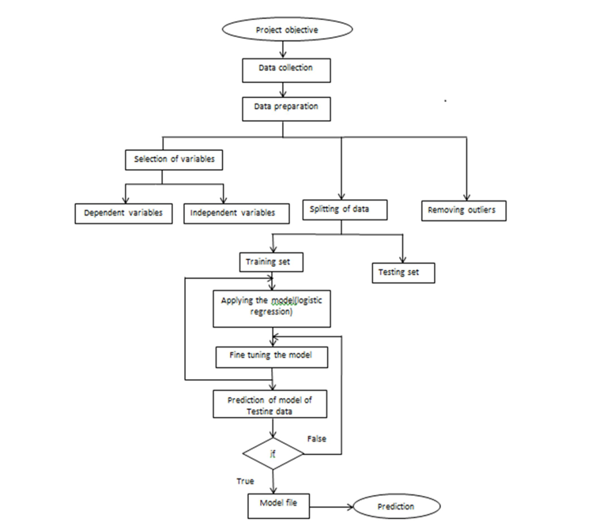
ARCHITECTURE:

Slide 5
SUGGESTIVE SYSTEM:
The college first designs the project object and collects the data; following data collection, we arrange the data into training and testing datasets. Outliers are eliminated once the data has been divided into dependent and independent variables..
he model design receives the training data in order to determine the training outcomes. The model is adjusted, and the training data is further categorized in accordance with the model's parameters. The testing dataset, which was previously saved, is further processed to the model for the prediction after the training data is available. The numbers are eventually assigned as the forecast if the testing results turn out to be accurate. If the testing values prove to be inaccurate, new values are supplied back for the model's fine-tuning.

Slide 6
PROCEDURAL MODEL TRAINING:
Data Export from Db :
For model training, the collected data from the database is exported in CSV format.
Data Preprocessing
use EDA to get insight into the data, such as spotting trends, outliers, and distributions. Check the columns for null values. Impute the null values if present. Use numerical numbers to encode the category values. For the values to be scaled down, use Standard Scalar.

Slide 7
Clustering –
The preprocessed data is clustered using the KMeans technique. The elbow plot is used to determine the ideal number of clusters, and the KneeLocator function is used to dynamically determine the number of clusters. The purpose of clustering is to apply various algorithms to structured data. The Kmeans model is developed using preprocessed data, and it is then stored for future prediction usage.
Model Selection –
Finding the ideal model for each cluster comes after the clusters have been formed. SVM and XGBoost, two algorithms, are employed. Both of the hyper-tuned algorithms are employed for each cluster. We figure out the AUC ratings for both models and choose the one with the highest rating. The model is chosen similarly for every cluster. Every cluster's models are retained for use in prediction.

Slide 8
RESULTS:
The likelihood of students being put in campus drives increases as a result of the proposed method. Both students and the institution can benefit from the "CAMPUS PLACEMENT PREDICTION." By being aware of the predictions made by this model, the school may concentrate on the possible students. The SUPPORT VECTOR MACHINE [SVM] is the method we employed since it provides accurate student placement results. The initiative primarily provides data regarding students' chances of being hired for campus drives, which is advantageous to both the students and the organisation.

